Slide 1

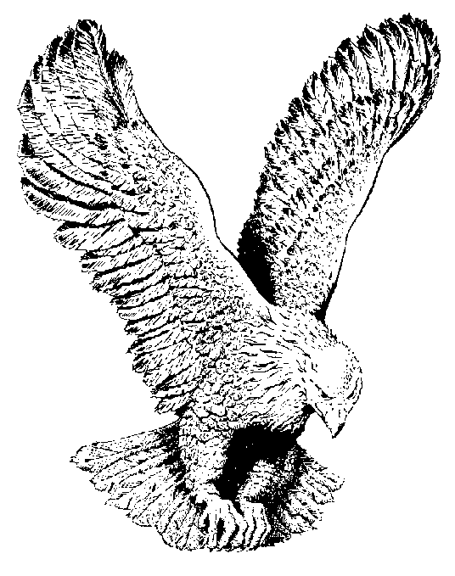
845 GOD ON THE THRONE
God is still on the throne,
He’ll never forsake His own,
His promise is true He’ll not forget you,
God is still on the throne.

